Slide 1
Internet Security (CI6240)
Week 1 – Introduction
Dr Martin Tunnicliffe
M.J.Tunnicliffe@kingston.ac.uk
Dr Eckhard Pfluegel
E.Pfluegel@kingston.ac.uk

Slide 2
This Module is NOT an Easy Option!!
CI6240 Internet Security is:
  A PROPER HONOURS LEVEL MODULE!!!
It has:
  A HIGH FAILURE RATE!!!
To pass it you must:
  Attend the lectures and workshops
  Do the homework
If you are not prepared to do this then
  YOU WILL GET A RUBBISH GRADE

Slide 3
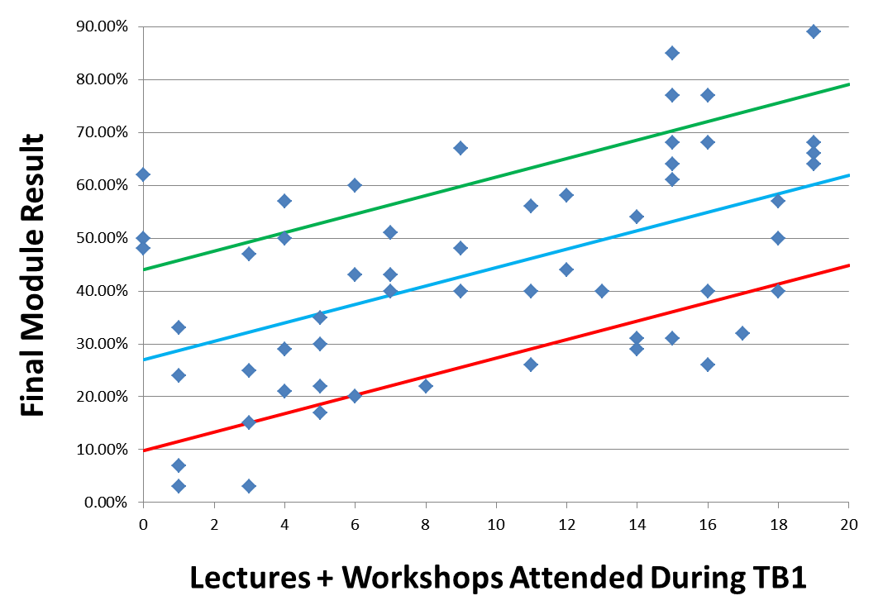
What Happened Last Year…

Slide 4
Learning and Teaching
Lectures
  Introduction and discussion of new concepts
  All lecture notes can be downloaded from Blackboard
Practical Workshops
  Instructions will be posted on Blackboard
  Portfolio of work assessed at end of module
Homework
  Reading/viewing assignment to prepare for the next week
  Multiple-Choice Online Quizzes
  Paper exercises (solutions posted the following week)

Slide 5
Lectures and Workshops
Come to all classes
  Unless there is a good reason why you cannot
    In which case e-mail me to let me know
  There will be a register
  I will chase persistent non attendees with snotty e-mails!
Ask questions
  After lecture/during workshop/during office hours.
    Contacting module instructors: see Module Guide
  Please switch off mobile phones during class
  Please arrive on time

Slide 6
Module Assessment Breakdown
 |  |  | Set Date | Due Date | Marker | Feedback Date | Return date
T1 | In-Class Test 1 | 15% | 06/12/16 | 06/12/16 | MT | 13/12/16 | 13/12/16
T2 | In-Class Test 2 | 15% | 14/03/17 | 14/03/17 | EP | 21/03/17 | 21/03/17
C | Coursework | 30% | 27/09/16 | 21/03/17 | MT/EP | 04/04/17 | 11/04/17
E | Final Examination | 40% | Date will be announced on “My Kingston” in TB2
Staff | Dr. Martin Tunnicliffe (MT) TB1 weeks 1-5, 7-12 Dr. Eckhard Pfluegel (EP) TB2 weeks 1-5, 7-12

Slide 7
Exam Paper Breakdown
Past exam papers (and solutions) are posted
  Take a look early on so you’ll know what to expect
There will be a mock exam in TB2
  Come along and do the exam
  Scripts will be marked and you will receive feedback
Total Examination (40%) | Compulsory Questions (20%) | Question 1: TB1 Material (10%)
 |  | Question 2: TB2 Material (10%)
 | Optional Questions (20%) | TB1 and TB2, any 2 questions from 4 options(10% each)

Slide 8
In-Course Summative Assessment
Two multiple-choice tests
  TB1 will be paper based MCQ
  TB2 test will be online (though you must attend to do it)
Practical work
  Before TB1 Reading Week: Maths and Cryptography
  After TB1 Reading Week: DeterLab
    Each week you will perform an experiment
    You will write up your best 3 DeterLab experiments and add them to your portfolio
    You will submit your complete portfolio at the end of TB2 for assessment.

Slide 9
Suggested Textbooks
  Cryptography and Network Security (any edition), William Stallings, Pearson.
    Mathematically somewhat above the level of this course – I would suggest skimming through the deep analytic proofs and concentrating on the architectures and algorithms.
    This book will serve you well if you intend to continue your Network Security studies to Masters level.
  Information Security Illuminated (any edition), Michael G. Solomon and Mike Chapple, Jones & Bartlett.
    Mathematically below the level of this module but contains some good general explanations of security principles. It is a good place to start learning about an unfamiliar topic.
  Many other relevant books in the library – go search!

Slide 10
Online Resources
Blackboard:
  Module guide, Lecture notes, Practical exercises
  Online quizzes and tests
  Gradebook
  Announcements
Internet
  Message boards
  Websites: e.g. http://computer.howstuffworks.com, http://nrich.maths.org/2200
  Wikipedia (careful though!)
  Search YouTube and Google

Slide 11
Required Background
Working knowledge of basic arithmetic
  More advanced mathematical topics will be introduced
  No prior knowledge will be assumed.
Familiarity with Computer Systems
  File manipulation
  Retrieving information from the Internet
  Word processing, E-mail
  Spreadsheets (MS Excel)
Basic Knowledge of Web Technologies
  Web pages, Web servers, Interactive Web Pages
Concept of Programming
  No extensive programming required, but you may find it useful to understand small pieces of JavaScript, pseudo-code etc.

Slide 12
Guidelines for Study
Each week:
  Print out lecture notes (available on Blackboard day before)
  Attend lecture and workshop (on time!) and take notes
  Do the quiz on Blackboard before following week’s lecture
  In workshop, download the exercises and do them
  Do the homework assignments (usually YouTube viewing)
Independent Study:
  Review notes after lecture and view suggested videos
  Seek out and study relevant websites, videos, magazine and newspaper articles
I do sometimes make mistakes!
  If you suspect an error anywhere in the course material please e-mail me straight away so I can put it right!

Slide 13
Teaching Block 1
Introduction
Mathematical Primer
Classical Cryptography
Digital Symmetric Ciphers
Public Key Cryptography
(Reading Week)
Cryptographic Hash Functions
Networks and Network-Based Attacks
Firewalls and Secure Architectures
Cryptography on the Internet
In-Class Test 1
TB1 Wrap-Up

Slide 14
Topics Covered This Week
What Is Security?
General Principles of Security
Notes:
These topics are not exhaustive, and the concepts will be built upon considerably in the coming weeks.

Slide 15
1.
What Is Security?

Slide 16
Opening Questions…
What are we dealing with?
  Information stored on computers
  Information transferred between computers (Internet)
  The computers themselves and associated equipment
What are we trying to achieve?
  Protection of information
  Control of information
  Protection and control of computers and associated equipment
Who is the Enemy?

Slide 17


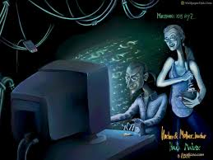
Who is the Enemy?
“Hacker” originally meant someone very good at programming
Nowadays it conjures up images like:
From Wikipedia: “Hacker: Someone who seeks to exploit weaknesses in a computer system or network.”
This is what I mean when I use the word “Hacker”.
There are also “ethical” (blue or white-hat) hackers who penetrate systems to reveal weaknesses to be addressed

Slide 18
The Malicious Insider
Nearly all security systems are designed to “keep the bad guys out”
Malicious insider therefore more dangerous than any outside hacker
This is especially true of security professionals and system admin staff
Try never to give any one person too much unconstrained power.
  Example: Edward Snowden

Slide 19
Non-Malicious Threats
Human error
Equipment failure
Software bugs/flaws
Natural occurrences
  Weather, earthquake, flood…

Slide 20
CIA Triad
Keeping Secret Data Secret
Protecting Data from Alteration
C
I
Confidentiality
Integrity
NETWORK
SECURITY
Availability
A
Keeping Resources Accessible to Rightful Users

Slide 21
Confidentiality
Access Control
  Keeping unauthorized users out of a system
  Preventing legitimate users from accessing data beyond their authorization
Message Encryption
  Allowing information to be exchanged confidentially over and insecure transmission medium.

Slide 22
Integrity
Secure data must only be changed through an authorized mechanism
Violations:
  Unauthorized users altering data
  Hackers faking origin of messages (authentication)
  Accidental alterations of data (e.g. noise, power surge corruption).
Cryptographic algorithms can sometimes protect both confidentiality and integrity.

Slide 23
Availability
Data is not useful unless it is available to legitimate users
An attacker who blocks users from the data they need is just as successful as one who steals or alters data.
  Example would be a Denial of Service Attack
  Distributed Denial of Service attacks can be lethal!

Slide 24

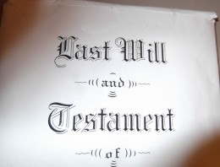
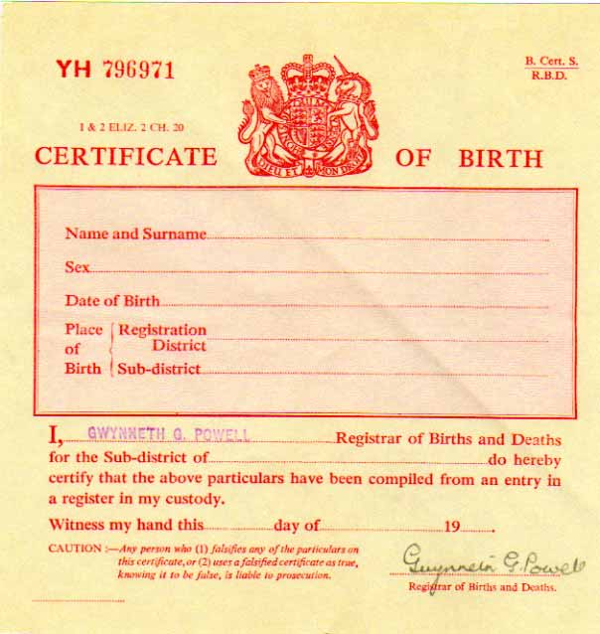


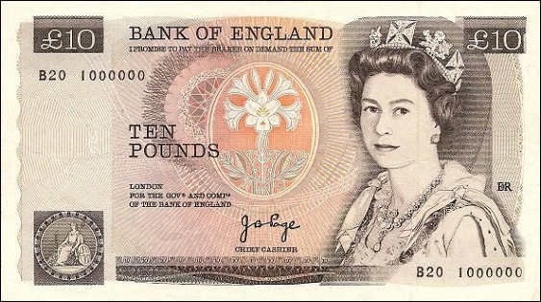
Examples of Documents…
Documents require both Confidentiality and Integrity
Integrity includes “Authentication” (verification of source)

Slide 25
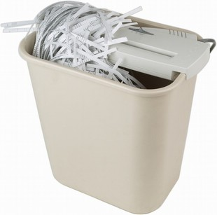
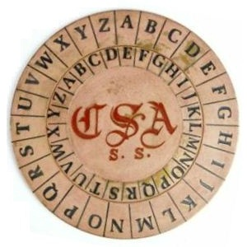
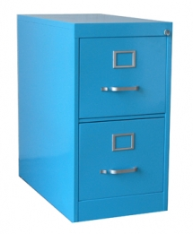

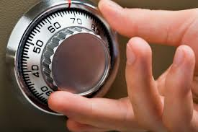
Document Confidentiality
Involves physical protection
  Safes
  Locked filing cabinets
  Shredding machines
Or secret writing/speech (cryptography)

Slide 26


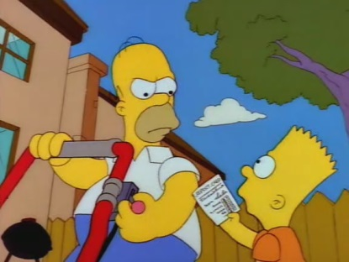
Physical Document Integrity
Integrity not difficult
  Documents are physical objects
Erasure/alteration leaves a mark.
Authentication
  Signatures, wax seals/seal rings
  Watermarks
  Difficult-to-copy patterns (banknotes)
  Xerox copies easily distinguished from originals
Homer: “You know a D turns into a B so easily! You just got greedy!”

Slide 27
With Networked Computers…
Documents no have no physical reality
  They exist as “files” within a computer memory (.doc, .pdf, .jpg etc).
  Computer must be protected from intruders
    Both physically and electronically (e.g. firewalls)
  Information in-transit needs protection
    Needs to be “encrypted” in case on interception
  There is no difference between the original and a copy!
    Need for electronic equivalents of signatures, watermarks etc.

Slide 28
DAD Triad
D
A
Disclosure
Alteration
NETWORK
INSECURITY
Denial
D

Slide 29
Disclosure
Examples:
  An external hacker gains access to your system and reads confidential data.
  An insider disseminates confidential data to outsiders (Edward Snowden)
  A programming fault allows customers to read other customers’ data
You can probably think of more examples

Slide 30
Alteration
Examples:
  A clumsy employee accidentally deletes database records.
  Somebody trips over a power cord during a data backup. Disks become corrupted and data unusable.
  A hacker steals a cashpoint card and accesses the database of PIN numbers. He alters the PIN so he can use the card.
Again many other examples

Slide 31
Denial
Examples:
  Server crashing
  Various types of DoS (Denial of Service) attacks
    Flooding a target network with packets
    Possibly using a “botnet” of compromised computers
    “Bacterium” processes infecting a target host, using up CPU resources
Again, many other examples.

Slide 32
2.
General Principles of Security

Slide 33
Major Principles of Security
Separation of Privileges
Least Privilege
Defence-in-Depth
Security through Obscurity

Slide 34
Separation of Privileges
No single person should have authority to cause a critical event to take place
Examples:
  No single military officer can launch a missile. Two officers must turn their keys simultaneously
  In aircraft maintenance, two technicians must sign off a repair before aircraft is declared operational
  On a computer system, no single administrator can create new accounts and assign administrative powers to those accounts

Slide 35
Least Privilege
No person in an organization should have more privilege than he/she needs to do his/her job.
Create very specific role-descriptors for personnel, with clearly defined privileges
Prevent “privilege creep”
  Any request for permission changes should be accompanied by an audit of existing privileges
  Privileges no longer needed should be revoked

Slide 36
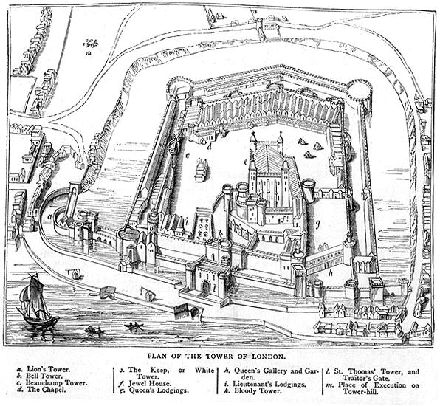
Defence in Depth
Multiple layers of defence
Security efforts concentrated at bottleneck points
Attacker needs to clear multiple hurdles before reaching sensitive components

Slide 37
Security through Obscurity
The idea that the security mechanisms of an organization should themselves be secret
Has benefits: the hacker begins his attack completely in the dark (unless he is a deep insider!)
Can be counterproductive since:
  Organizations must rely on their own internal expertise to design security controls
  Better mechanisms can be developed by cooperation within the global scientific community
  Mechanisms can be tested more rigorously if they are not secret

Slide 38
Security through Obscurity
Modern security does not usually rely on obscurity
Kerckhoff’s Principle:
  “Cryptosystem should be secure even if everything about it is known except the key” (Auguste Kerckhoff, 1835-1903)
Shannon’s Maxim
  “The enemy knows the system” (Claude Shannon, 1916-2001)
Example: Rijndael algorithm for the AES cryptosystem was winner of public competition
Exception: Red Pike encryption algorithm

Slide 39
Some more definitions…
Threat: set of circumstances with potential to exploit vulnerability and create a risk of harm
Vulnerability: potentially exploitable weakness
Risk: occurs if both threat and vulnerability exist
Control: countermeasure, procedure, device or technique used for protection
Threat
Risk
Vulnerability
Notes:
As we have seen, we have to examine our system and try to find weaknesses
We define the term “vulnerability” as a weakness which is potentially exploitable.
A “threat” is a possible danger, a set of circumstances which might cause harm.
For example, if we have a dam holding back water and there is a crack in the wall, the water is the threat and the crack is the vulnerability.

Slide 40
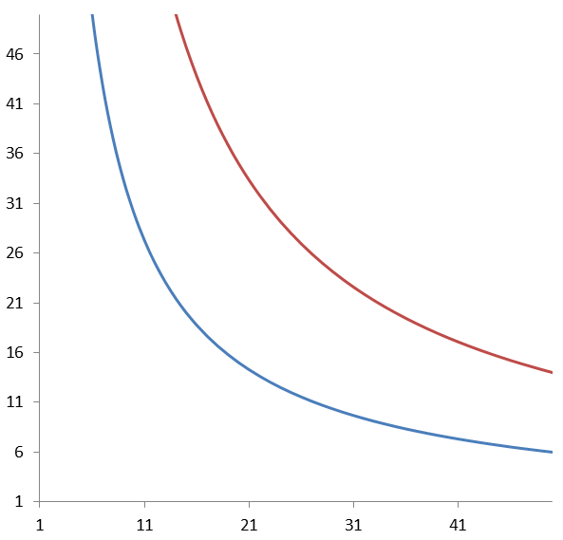
Another concept of “Risk”
CONTROLS
Reduce Impact and Probability
Live with it
Risk = Probability × Impact
Probability
High Risk
Moderate Risk
(Worry?)
Low Risk
Plan for it! (disaster recovery)
Impact
Notes:
Numbers of course are purely conceptual

Slide 41
Aims and Requirements
Impossible to “guarantee” security
  Realistic purpose of computer security: minimize risks
The basic methodology in Computer Security is:
  We think about uncovered vulnerabilities in our system
  Then we consider available controls
  Constant re-evaluation is necessary
  Review existing controls
  Identify areas where more work is needed
  Monitor technological progress
  Anticipate potential new threats
  Stay informed: for example: http://www.cert.org

Slide 42
Summary
General Principles of Security
  Separation of Privileges
  Least Privilege
  Defence-in-Depth
  Obscurity
Security Methodology
  Threats
  Vulnerabilities
  Risks
  Controls

Slide 43
Homework
Do the Online Quiz
Do the “Spread Spectrum” homework exercise
Watch the lecture by Professor Raymond Flood entitled “The Queen of Mathematics” available at https://www.youtube.com/watch?v=lzyWL1LTlq4
  Don’t worry if you don’t understand all of this yet – it is mostly to “set the scene” for the maths review lecture next week.
  However, the lecture does introduce and discuss several of the concepts you will be studying over the next few weeks
Next week’s Lecture: Remember to bring with you a pencil and an eraser!

